Slide 1
1200-A Permit Status and YDO for Registrants
DEQ Update
Feb 1, 2024
Chemeketa Center for Business and Industry, Salem
Daria Gneckow | Oregon Department of Environmental Quality

Slide 2
Content
1200-A & 1000 WPCF permit status/renewal
Your DEQ Online (YDO)
Other developments

Slide 3
1200-A Permit Status
Expired in 2017, administratively extended
Registrants responsible for continued compliance
New operators should apply for permit coverage
Follow permit conditions except reporting
Notes:
DEQ administered sites should apply via YDO, DOGAMI sites via paper application process

Slide 4
1200-A Permit Renewal
Delayed due to COVID and YDO implementation
New TMDL considerations
Renewal schedule is TBD
Website will be updated with timeline
DEQ to let registrants know how to participate in the public process
Sign up for GovDelivery under stormwater (and YDO)
Notes:
DEQ staff assigned to begin renewal process
DEQ internal draft
Agent input (DOGAMI, City Portland BES)
Industry Engagement, informational sessions
Public comment
Some renewal considerations Newly issued TMDL that identify DOGAMI as DMAs and the 1200-A implementation responsibilities
2019 Willamette Basin Mercury TMDL
2019 Upper Klamath and Lost River Temp. TMDL
New Integrated Report draft planned for public comment early 2024
New Fish and Aquatic Life rulemaking updating fish use maps and beneficial use tables
New federal industrial stormwater requirements for mining facilities since the current permit was issued

Slide 5
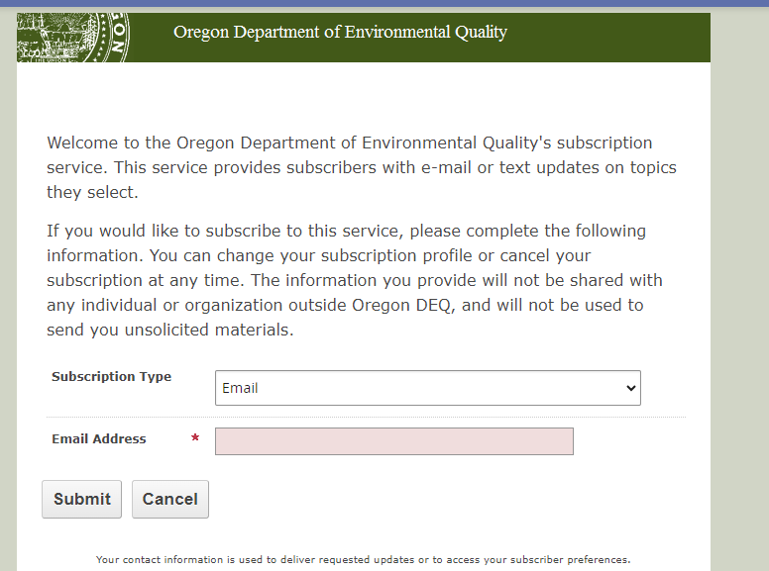
https://public.govdelivery.com/accounts/ORDEQ/subscriber/new

Slide 6
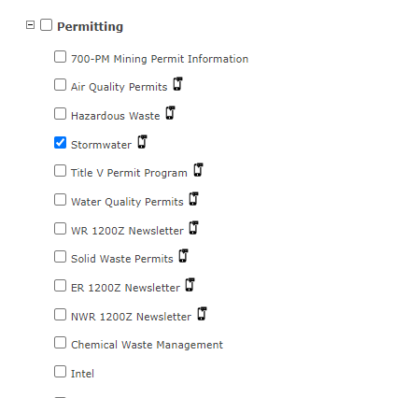

Slide 7
WPCF 1000
Required for aggregate mining operations that discharge wastewater to the ground
Expired in 2017 and administratively extended
DEQ assigned staff to renew
Expected within 2024
Opportunity for industry engagement

Slide 8
DEQ Permit Renewal Contacts
1200-A:
Krista Ratliff
Industrial Stormwater Program Coordinator
krista.ratliff@deq.oregon.gov
503-893-0669
1000 WPCF:
David Feldman
Senior Permit Writer
david.feldman@deq.oregon.gov
503-887-3469

Slide 9
Your DEQ Online “YDO”
Your DEQ Online is a technology solution to help many of our programs work more efficiently and effectively with regulated entities and the public to serve the environmental quality needs of our state.

Slide 10
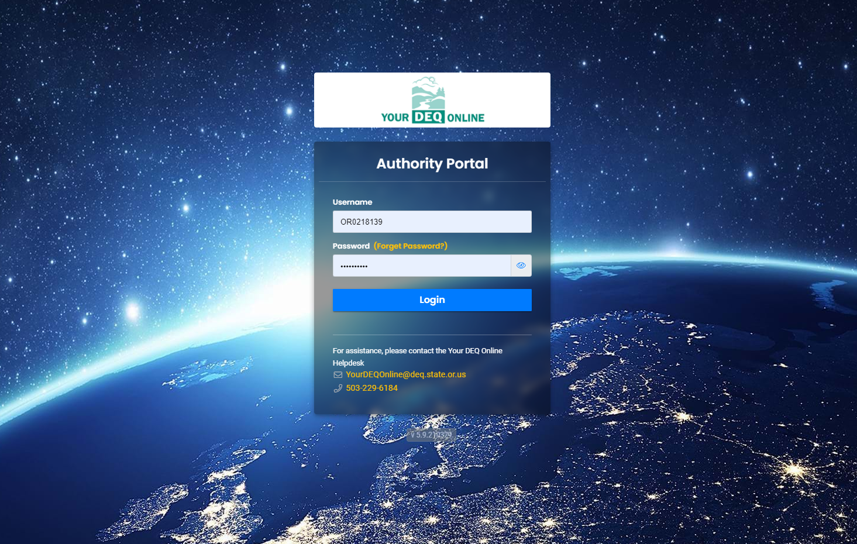

Slide 11
YDO – Live Programs
Air Quality
Asbestos Program (as of Aug 12, 2021)
Gasoline Transporter Program (as of May 4, 2021)
Land Quality
Hazardous Waste (as of Oct 7, 2021)
Water Quality
401 Certification (as of Oct 1, 2021)
Industrial and Construction Stormwater (as of Oct 1, 2021)
Sewage Disposal Service Business License (as of Dec 7, 2022)
Underground Injection Control (as of Oct 1, 2021)
Wastewater Operator Certification (as of Mar 14, 2023)
Climate Protection Program
Climate Protection Program (as of Sept 1, 2023)
Greenhouse Gas Reporting and Third-party Verification (as of Nov 29, 2023)
Agency-wide Services
Pollution Complaints Program (as of Sept 27, 2023)
Payments, enforcement, public notices, etc.
DEQ’s 1200-A sites

Slide 12
Coming in 2024
Land Quality
Cleanup, Leaking Underground Storage Tanks and Heating Oil Tanks
Solid Waste Permits
Underground Storage Tanks and Heating Oil Tanks Licensing
Water Quality
NPDES and WPCF General Permits
NPDES and WPCF Individual Permits
WPCF Onsite Permits
Air Quality
Air Contaminant Discharge Permits
Area Source Registration
Emissions Inventory Reporting
Title V Permits
1000 WPCF – Aug 2024

Slide 13
Agent-administered Permits into YDO
Pending agent agreement renewals
Test environment
Agent staff training
Timeline TBD

Slide 14
Account types
Responsible Official (RO)
Legally accountable for submittals
Consultant
Can prepare submittals for ROs
General Public
Respond to public notices, pay invoices
Notes:
Responsible Official (RO) – Users with RO accounts must complete an identity verification process. Once verified, RO account users can link to facilities if applicable. They can select types of submittals and link to consultants who help to prepare submittals. ROs can prepare, certify and submit documents to DEQ; amend, renew or withdraw submittals; and view submittal history.
Consultant – Users with Consultant accounts must be linked by ROs if they will be assisting with facilities and submittals. Once linked, Consultants can prepare documents on behalf of ROs and use the system for messages, data entry, queries and submittal tracking. Consultants cannot certify and submit documents to DEQ on behalf of ROs.
General Public – Users with General Public accounts can pay invoices and respond to public notices. General Public users cannot prepare or certify and submit submittals including documents or reporting obligations to DEQ.

Slide 15
Data Access
These accounts have different data access privilege
No confidential business information or personal data
Does not replace Public Records Request system

Slide 16
Resources
DEQ website
demonstrations
user guidance
webinar dates
Dedicated help desk with phone number and email

Slide 17
www.oregon.gov/deq/Permits/Pages/Your-DEQ-Online.aspx

Slide 18
Positive developments
Stormwater permitting is fully staffed
New program manager Benjamin Benninghoff 6 month milestone; to lead the renewal process
Leah Feldon as new director and Jennifer Wigal as WQ administrator

Slide 19
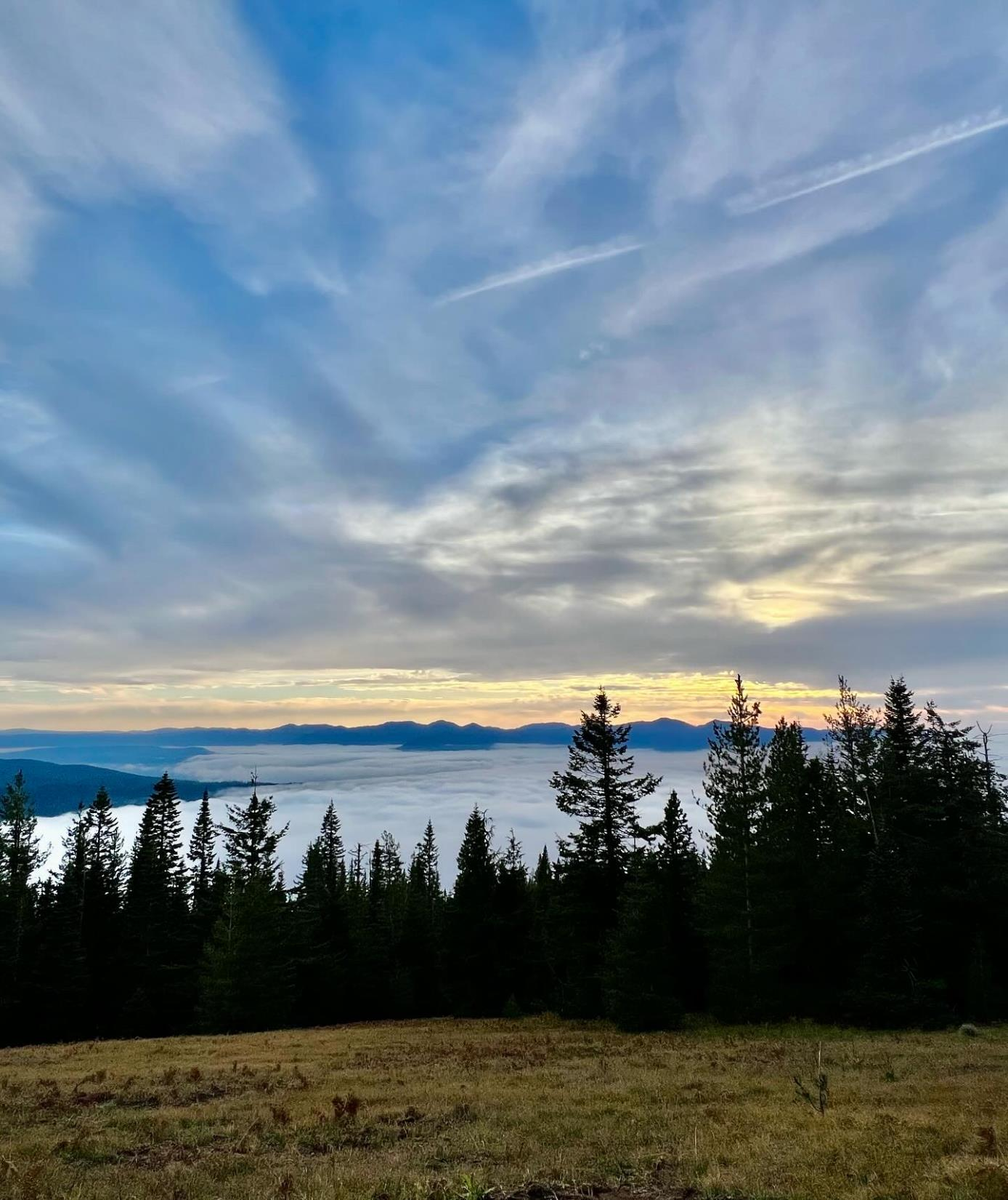
Thank you!
Daria Gneckow
Construction Stormwater Program Coordinator
daria.gneckow@deq.oregon.gov
503-437-5074
Notes:
Photo: Dgneckow – McKenzie River Valley

Slide 20
Title VI and alternative formats
DEQ does not discriminate on the basis of race, color, national origin, disability, age or sex in administration of its programs or activities.
Visit DEQ’s Civil Rights and Environmental Justice page.
Español | 한국어 | 繁體中文 | Pусский | Tiếng Việt | العربية
Contact: 800-452-4011 | TTY: 711 | deqinfo@deq.state.or.us

